Slide 1
Introduction to 3d printing
By: David Garvin

Slide 2
Agenda
Types of 3d printers
Types of materials used in 3D printing
Websites to find items to print
Overview of 3D printing software options
Popular printer manufacturers and models
Examples of 3D printing

Slide 3
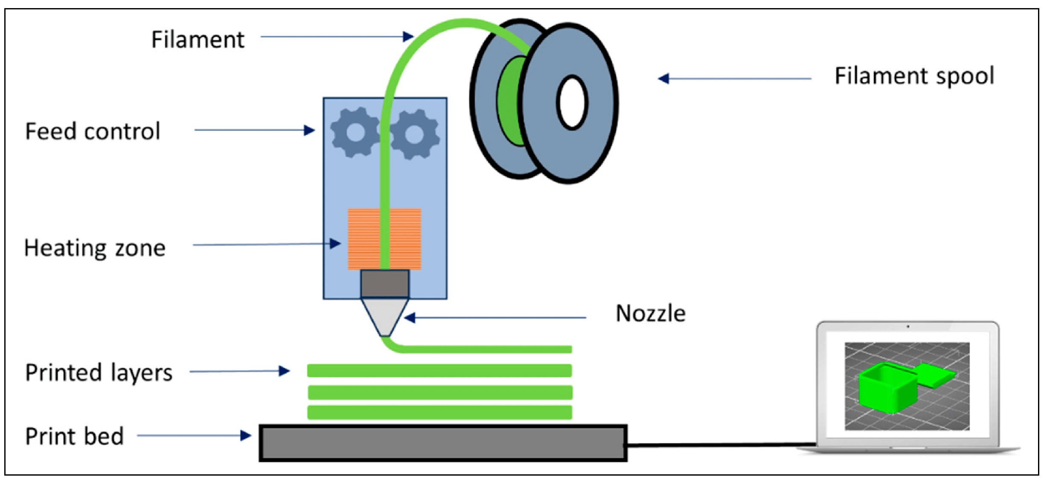
FDM Printing (Fused Deposition Modeling)
Extrudes filament through nozzle to build objects layer by layer
Most common type
Filament-based
Easiest to use
<Insert a picture or drawing of your prototype here>

Slide 4
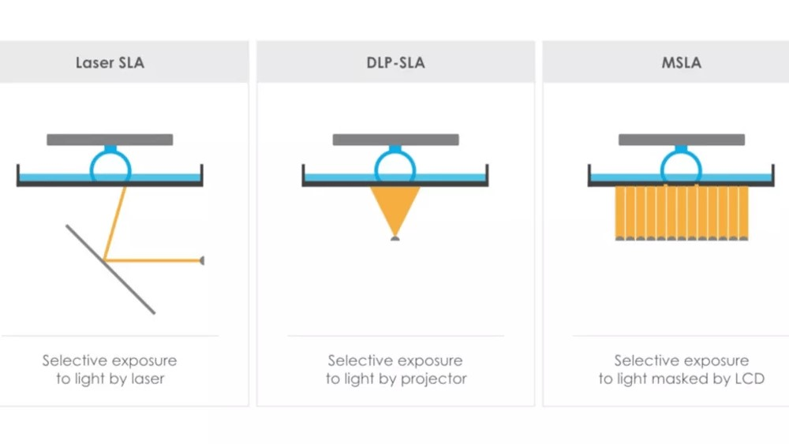
Resin Printing (SLA)
Uses light to solidify liquid resin to build object layer by layer
Best for high detail
Difficult to clean/cure
Difficult to use

Slide 5
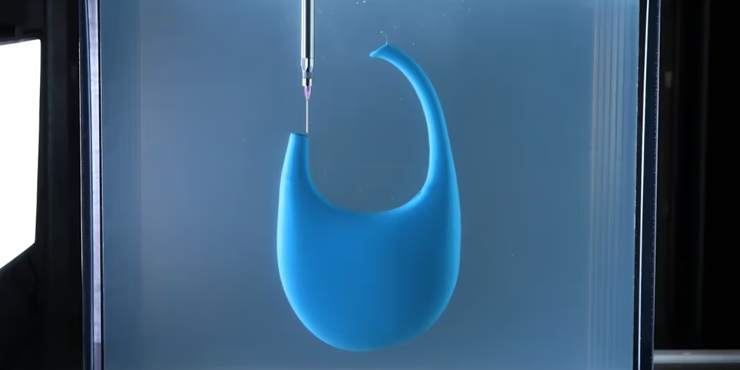
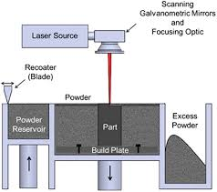
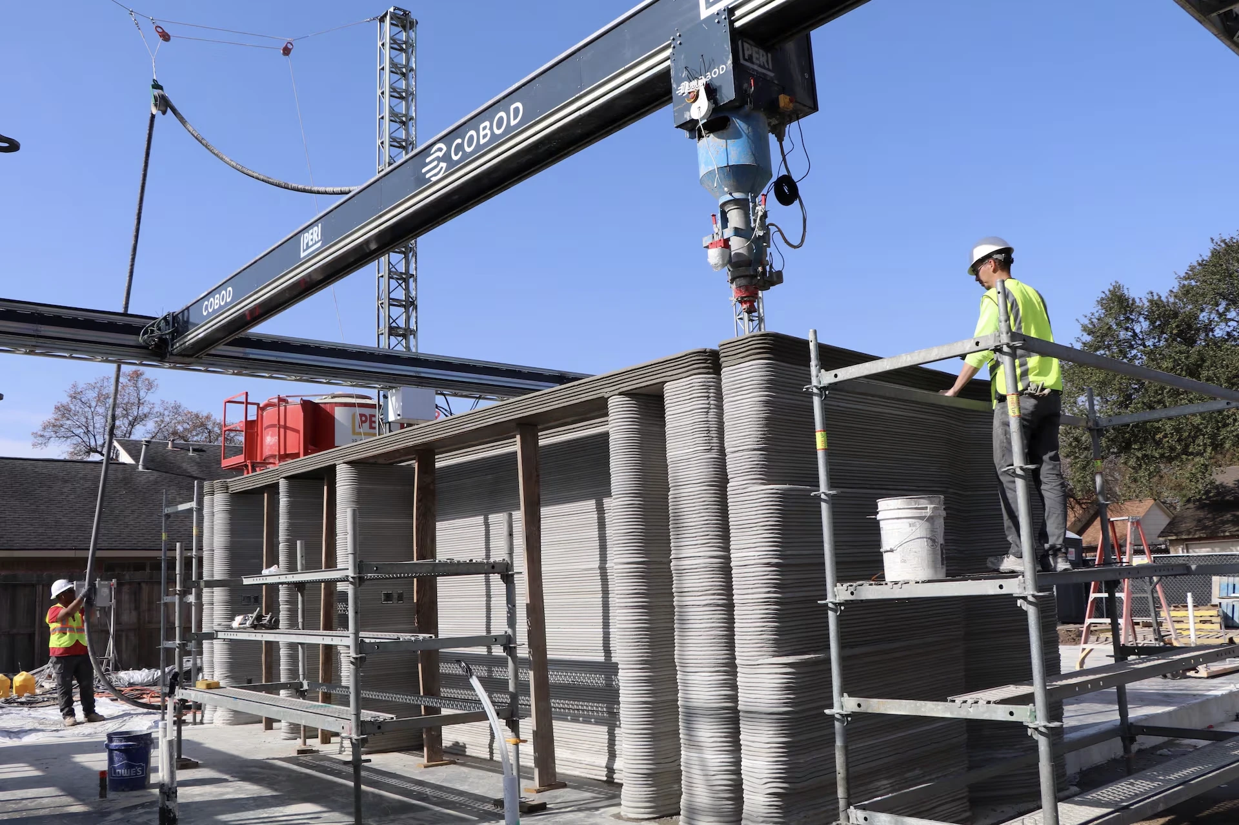
Other types of 3d printing
Gel printing
Laser powder bed fusion (LPBF)
Concrete 3d printing

Slide 6
Types of 3d printing materials
PLA – biodegradable, cheap, easy to print
PETG – water resistant, strong, flexible, challenging to print
ABS – heat resistant, UV resistant, difficult to print
TPU – flexible, very difficult to print
Infused (Metal/Wood/Glass Fiber/Carbon Fiber) – added strength, ability to apply stain (wood), needs high temp capable printer
Resin – best for high detail, fragile, significant post process work

Slide 7
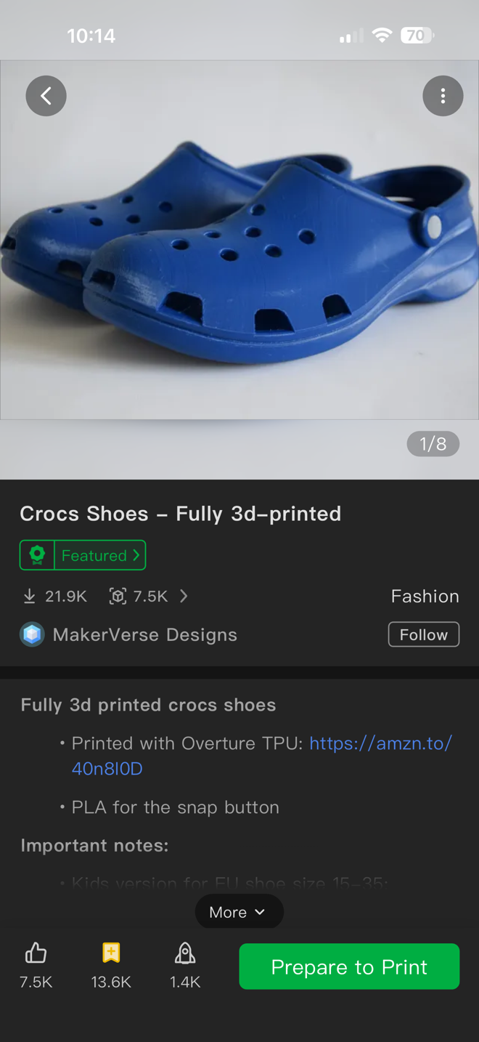
Where to find prints
MakerWorld.com
Thingiverse.com
Printables.com
Thangs.com
Cults3D.com
MyMiniFactory.com

Slide 8
3D printing software
Design
Tinkercad – beginner friendly
Fusion 360 – powerful CAD
Blender – for organic shapes
FreeCAD – open source
Shapr3D – designed for iPad
Prepare
Bambu Studio
Cura
Prusa
Orca

Slide 9
Current Printer Market
Bambu Lab (199 to 2,899) – fast, beginner friendly
Prusa (429 – 9,990) – reliable, enthusiast favorite
Creality (169 – 1,299) – budget friendly
Anycubic/Phrozen (Resin & FDM) (349 – 849) – budget friendly for resin
Elegoo (Resin & FDM) – (169 – 2,499) – fast and reliable resin

Slide 10
What to look for when selecting a printer
Decide what you will be using it for
Where will you keep the printer
Build volume size
Max nozzle temp
Nozzle size/resolution
Auto bed leveling (Must)

Slide 11
Questions and printed examples

